Slide 1
PageRank
Hung-yi Lee
Notes:
Begin
1.
Idea: eigen value =1
2.
Dim of eigen value = 1 is 1 unique (add M)
3.
Power method
end

Slide 2
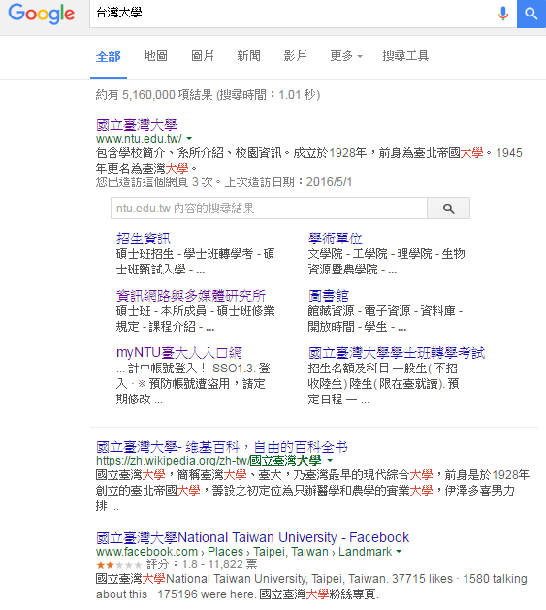

Search
http://incomebully.com/does-pr-pagerank-still-matter/
Notes:
How to rank

Slide 3
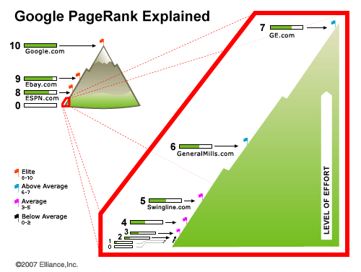
http://www.hobo-web.co.uk/google-pr-update/

Slide 4
PageRank
Rank：8
Google台灣首頁：www.google.com.tw
Youtube台灣首頁：http://tw.youtube.com
台灣大學網站首頁：www.ntu.edu.tw
Information of 2008
Rank：7
痞客邦首頁：www.pixnet.net
104人力銀行：www.104.com.tw
無名小站首頁：www.wretch.cc
Rank：6
博客來網站：www.books.com.tw
聯合新聞網首頁：http://udn.com
天下雜誌網站首頁：www.cw.com.tw
Rank：5
推推王網站：http://funp.com
愛情公寓網站：www.i-part.com.tw
KKman網站首頁：www.kkman.com.tw
Rank：4
工頭堅部落格：http://worker.bluecircus.net
白木怡言部落格：www.yubou.tw
RO仙境傳說網站：http://ro.gameflier.com
Source: http://terrylogin.blogspot.com/2008/09/pagerank.html

Slide 5
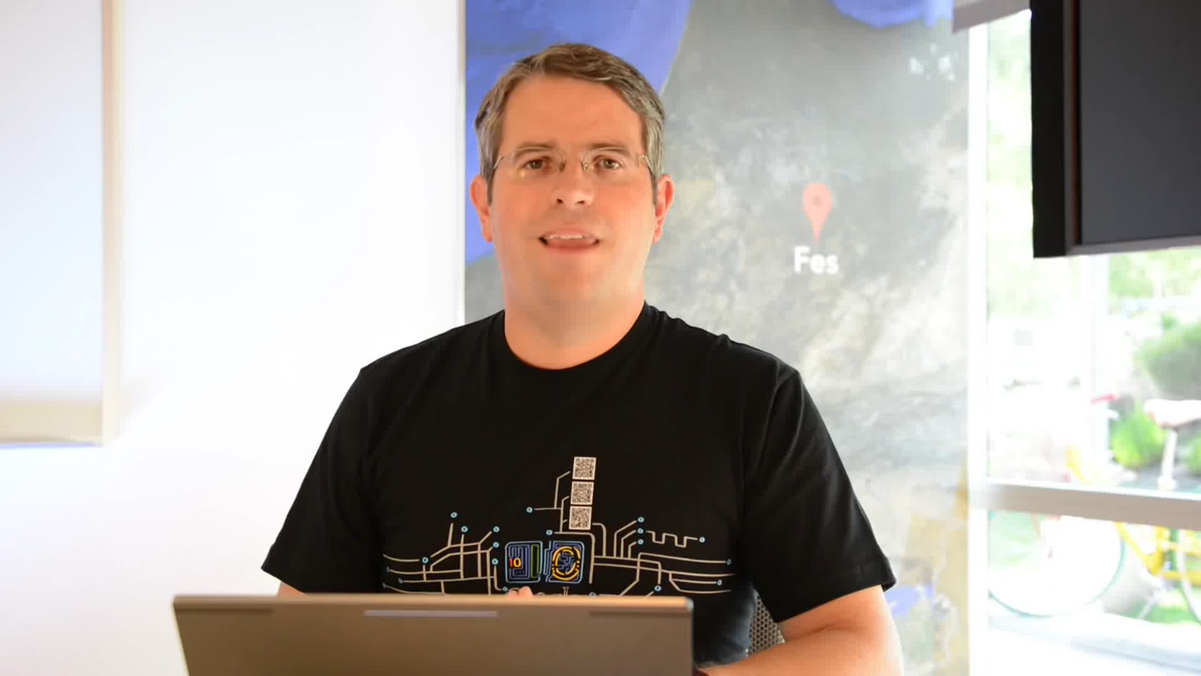
PageRank

Slide 6
PageRank
Webpages with a higher PageRank are more likely to appear at the top of Google search results.
PageRank relies on the uniquely democratic nature of the web by using its vast link structure as an indicator of an individual page’s value.
Google interprets a link from page A to page B as a vote, by page A, for page B.

Slide 7

Importance
很多網頁連到
被重要網頁連到
很多網頁連到
hyperlink

Slide 8
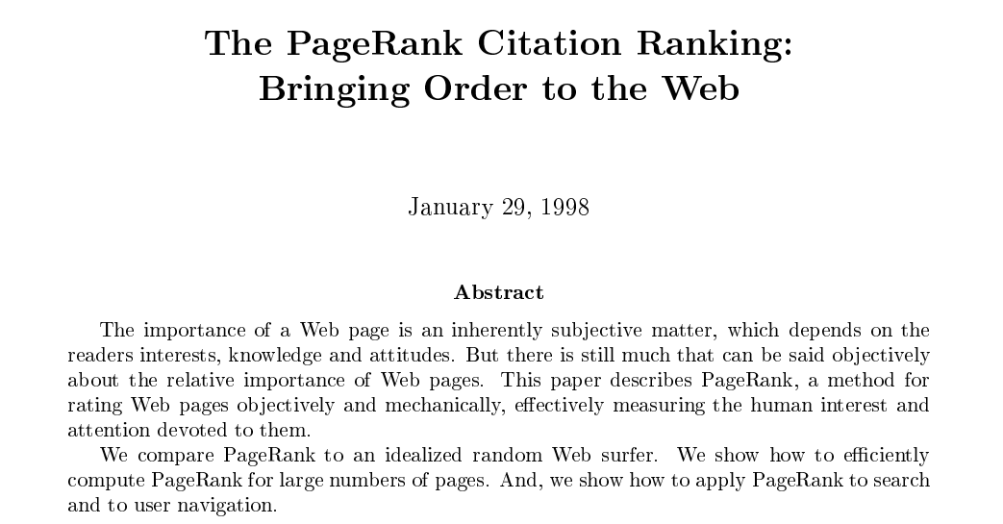

PageRank

Slide 9

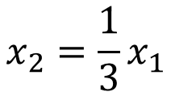

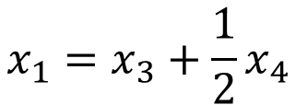


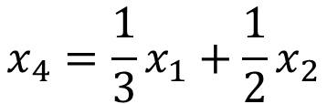

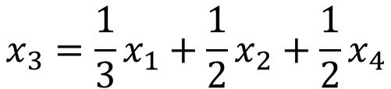
Importance - Formulas
$$x_{1}$$
$$x_{3}$$
$$x_{1}=x_{3}+\frac{1}{2}x_{4}$$
1
3
$$x_{2}=\frac{1}{3}x_{1}$$
$$x_{3}=\frac{1}{3}x_{1}+\frac{1}{2}x_{2}+\frac{1}{2}x_{4}$$
1/2
2
4
$$x_{4}=\frac{1}{3}x_{1}+\frac{1}{2}x_{2}$$
1/2
$$x_{2}$$
$$x_{4}$$
Consider a random surfer
Notes:
Depned on others, but normalization is needed
surfer

Slide 10
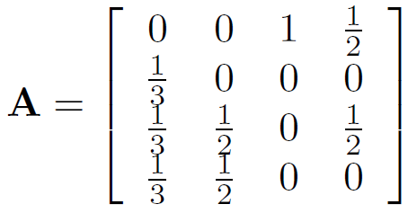

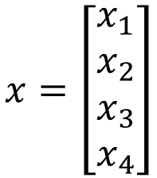
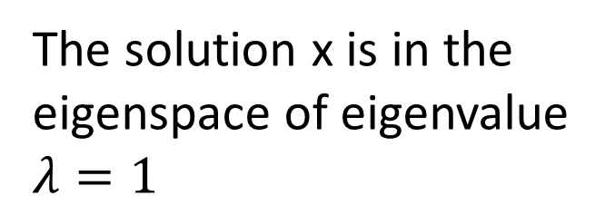
Importance - Formulas
$$x=\left[\begin{aligned}x_{1} \\ x_{2} \\ x_{3} \\ x_{4}\end{aligned}\right]$$
$$x_{1}=x_{3}+\frac{1}{2}x_{4}$$
$$x_{2}=\frac{1}{3}x_{1}$$
$$Ax=x$$
$$x_{3}=\frac{1}{3}x_{1}+\frac{1}{2}x_{2}+\frac{1}{2}x_{4}$$
The solution x is in the eigenspace of eigenvalue $λ=1$
$$x_{4}=\frac{1}{3}x_{1}+\frac{1}{2}x_{2}$$
Notes:
Eigen value = 1

Slide 11





Importance - Formulas
$$x_{1}$$
$$x_{3}$$
12
9
$$x=\left[\begin{aligned}x_{1} \\ x_{2} \\ x_{3} \\ x_{4}\end{aligned}\right]$$
1
3
$$Ax=x$$
The solution x is in the eigenspace of eigenvalue $λ=1$
2
4
$$x_{2}$$
4
6
$$x_{4}$$
$$Span\left\{{\left[\begin{matrix}\begin{matrix}12 & 4\end{matrix} & \begin{matrix}9 & 6\end{matrix}\end{matrix}\right]}^{T}\right\}$$
Notes:
Hack this????????????????????

Slide 12
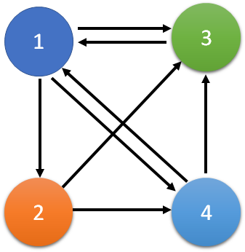


Eigenvalue = 1
$$Ax=x$$
Column-stochastic Matrix
Column-stochastic matrix always have eigenvalue $λ=1$
Proof
How about the Dangling nodes (只入不出)?

Slide 13

Unique Ranking?
$$x_{1}$$
$$x_{3}$$
12
9
1
3
Having eigenvalue $λ=1$
The dimension of the subspace is must 1
2
4
Unique Ranking
$$x_{2}$$
4
6
constraint
$$x_{4}$$
Unique Score

Slide 14

Unique Ranking?
How about dimension > 1
Dim for $λ=1$ is 2
Basis:
1/2
1
0
3
0
1
1/2
3
0
5
0
5
1/2
2
0
4
0
2
1/2
4
Any linear combination is in the eigenspace
Not Unique Ranking
Notes:
Example of number
Random surfer

Slide 15
Unique Ranking?
Can it be non-uniform?
All entries are 1/n
0.15
Follow the link
random
There are two ways to surf the web
Prob 1 – m:
Prob m:
1
3
1
3
5
5
2
4
2
4

Slide 16


Unique Ranking?
Unique ranking
For M, the dim of the eigenvalue $λ=1$ is 1
M is Column-stochastic matrix and “positive”
Proof
Dim = 1
Hint: For M, the eigenvectors for eigenvalue $λ=1$ are all “positive” or “negative”

Slide 17







Power method
M is very large
Find $x^{∗}$, such that $x^{∗}=Mx^{∗}$, ${\left\|x^{∗}\right\|}_{1}=1$
Start from $x_{0}{,\left\|x_{0}\right\|}_{1}=1$
$$x_{1}=Mx_{0}$$
$$x_{2}=Mx_{1}$$
If $k→∞$
$$x_{k}=x^{∗}$$
……
$$x_{k}=Mx_{k−1}$$
Proof

Slide 18
Power method - Example
1
3
2
4
Notes:
demo

Slide 19
Actually ……
The Last Toolbar Pagerank Update was December 2013
Google declared thereafter: “PageRank is something that we haven’t updated for over a year now, and we’re probably not going to be updating it again going forward, at least the Toolbar version.“
Notes:
https://www.gotchseo.com/increase-google-rankings/

